Slide 1
Pediatric pneumonia Bacterial and Other Pneumonias
DR. D. OBUON
Supervisor: DR. G. MWANGO

Slide 2
Contents
Patterns of bacterial pneumonia
Neonatal pneumonia
How pneumonia resolves
References

Slide 3
Chest radiograph is primary imaging technique for evaluation of acute pediatric lung disease.
CT has role in immunocompromised patients ,& in acute & chronic complications of respiratory tract infection e.g empyema,bronchiectasis etc.
Frontal chest X-ray usually adequate to confirm or exclude pulmonary infection/pneumonia.
Lateral chest X-ray ordered only if frontal is not conclusive .

Slide 4
Pediatric presentation will sometimes be different from adult
Poor collateral ventilation before age 8
smaller in size
fewer alveoli
higher airway resistance –narrow airways
NB
chest radiograph is not always accurate, consider clinical presentation and lab findings in final diagnosis
Notes:
chest radiograph is not always necessary or even useful as an aid in determining the etiology of the infection.
Several studies indicate that chest radiograph is only 42-73% accurate in predicting the etiology of a case of pneumonia.
.Therefore clinical presentation and other laboratory findings MUST be considered in the diagnosis of pneumonia.

Slide 5
Differentiating Bacterial and Viral pneumonia by CXR
Viral lung infection is more common than bacterial Within all pediatric age groups.
Bacterial pneumonia, in general, causes inflammation WITHIN alveoli resulting in oedema /INTRA-ALVEOLAR exudate thus consolidation WITHIN the air spaces.
Results in presence of ‘air bronchograms’

Slide 6
Viral infection usually affects respiratory mucosa & airways walls , causing bronchial & bronchiolar edema and partial bronchial obstruction ( due to peri bronchial thickening)
Results in :
Generally demonstrate interstitial Pattern. But also;
Segmental and sub segmental atelectasis (Lung collapse)
Air trappings and hyperinflation.
small patches of consolidation frequently occurring in peri hilar location

Slide 7
NB;
CXR not accurate in differentiating bacterial and viral lung infections since mixed infections are common and the radiological features of viral and bacterial pneumonias often overlap.

Slide 8
Patterns of Bacterial pneumonia :
Lobar pneumonia
Segmental pneumonia
Interstitial pneumonia- Usually viral but Mycoplasma pneumoniae show both consolidative and interstitial pattern.
Round pneumonia
Cavitary pneumonia

Slide 9
Lobar pneumonia
Streptococcus pneumoniae in >90% cases
Disease fills most or all of a lobe of the lung
1 or more margins may be sharply marginated because lobes are bound by interlobar fissures
Other edges are indistinct and irregular
Silhouette sign produced where consolidation is in contact with the heart, aorta or diaphragm
Almost always contain air bronchograms
Notes:
Right upper lobe pneumococcal pneumonia. There is airspace disease in the right upper lobe that occupies the entire lobe. Because lobes are bounded by interlobar fissures—in this case, the minor or horizontal fissure (white arrow)—the inferior margin of the pneumonia is sharply marginated. Where the disease contacts the ascending aorta (black arrow), the border of the aorta is silhouetted by the fluid density of the pneumonia.

Slide 10
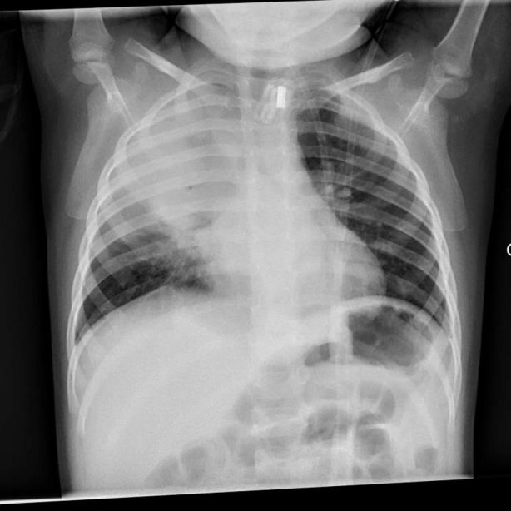
Frontal CXR
Pediatric age group
at least 8 posterior ribs seen
Opacification; lobar pattern
Air bronchogram seen

Slide 11
Segmental pneumonia (bronchopneumonia)
Staphylococcus aureus, Pseudomonas aeruginosa
Spread centrifugally via tracheobronchial tree to many foci in the lung at the same time
Involves several segments of the lung simultaneously
Margins tend to be fluffy and indistinct
No air bronchograms, exudate displace air in the small airways
Notes:
There are multiple irregularly marginated patches of airspace disease in both lungs (white arrows).

Slide 12
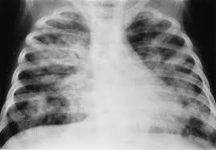
Bronchopneumonia
Consolidation Involves several segments of the lung simultaneously

Slide 13
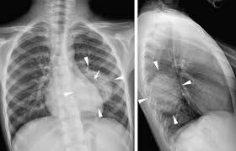
Round pneumonia
Pneumonia in children can assume a spherical shape
Almost always posterior in the lungs, usually in the lower lungs
Haemophilus influenza, Streptococcus and Pneumococcus
May be confused with a tumour mass
Consolidation is spherical in shape
Can be confused with a mass
Usually posterior segments involved
Notes:
There is a soft tissue density in the right midlung field that has
a rounded appearance (white arrows). This is a 10-month-old child who had a cough and fever. This
is a characteristic appearance of a round pneumonia, most common in children, and frequently due
to either Haemophilus, streptococcal, or pneumococcal infection

Slide 14
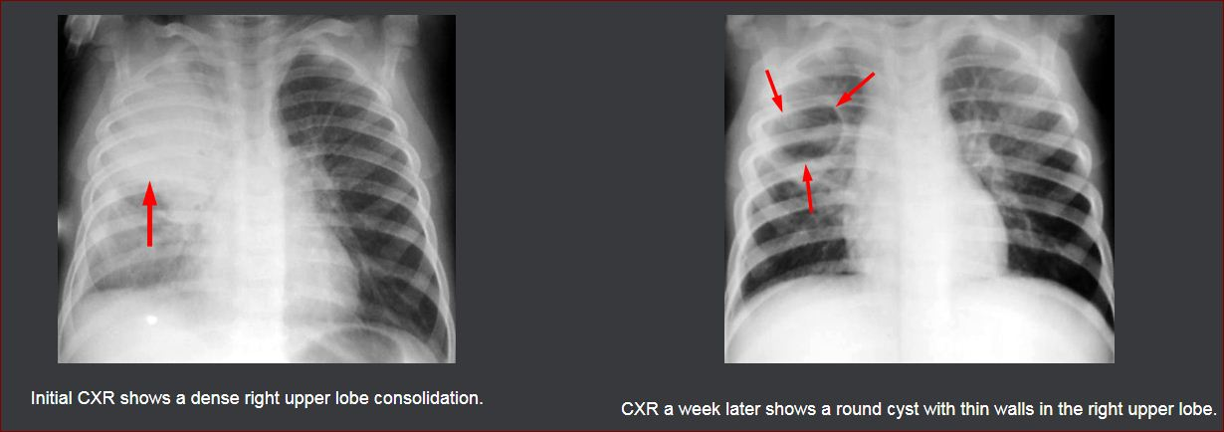
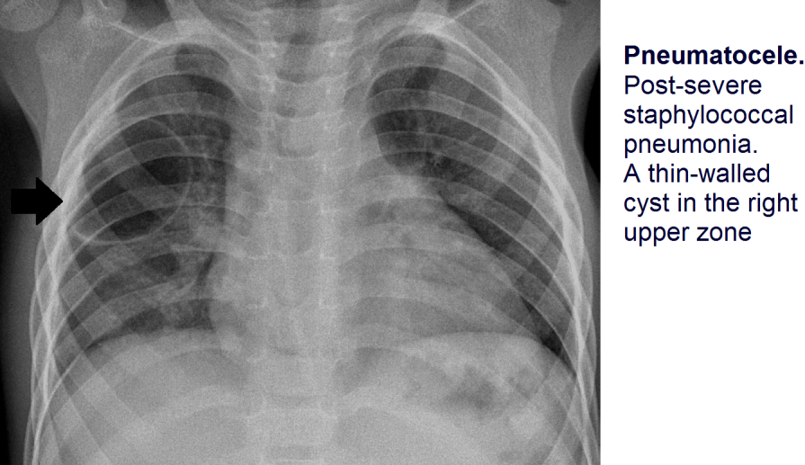
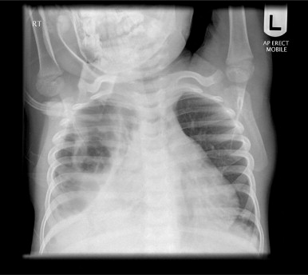
Necrotising/Cavitatory Pneumonia
Associated with staphylococcal & less frequently Klebsiella infection
Thin-walled pneumatoceles are classic sequelae of staphylococcal infection

Slide 15
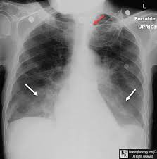
Aspiration pneumonia
Due to aspiration of foreign material into the tracheobronchial tree are :
neurologic disorders ; altered mental status, GERD and post-operative effects from head and neck surgery
Occurs in the dependent portions of the lung
Upright- lower lobes, right side>left
Recumbent- superior segments of the lower lobes / posterior segment of upper lobes
Clinical History critical.
Notes:
bilateral lower lobe airspace disease in a patient who had aspirated (black
arrows).

Slide 16
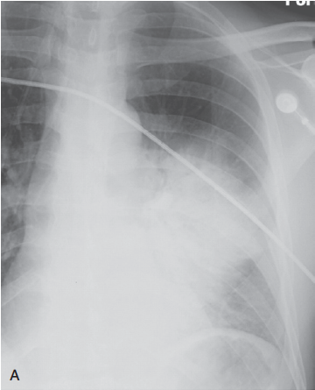
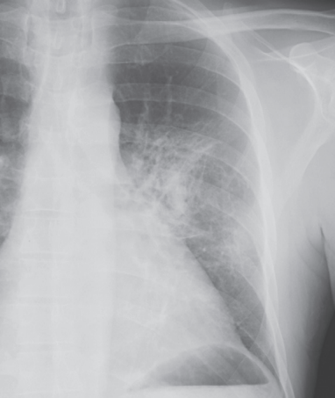
How pneumonia resolves
Can resolve in 2 - 3 days if organism is sensitive to the antibiotic administered
Typically resolve from within (vacuolisation) gradually disappearing in a patchy fashion over days
Consider an underlying obstructing lesion if it does not resolve in several weeks

Slide 17
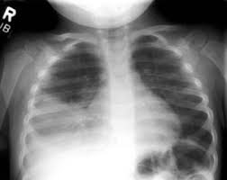
Neonatal pneumonia
Infections occur via ascending infection from vagina, transvaginally during birth (group B strep) or hospital acquired
Risk Factors ;PROM ,Prolonged labor, placental infection, and ascending infection from the perineum
Chest X-RAY findings: coarse bilateral asymmetrical alveolar opacification +/-asociated interstital change
Notes:
Most occur during birth- swallows /aspirates infected amniotic /vaginal secretions
Small bilateral pleural effusions

Slide 18
Recurrent / persistent pneumonia
Infection within a pre-existing lung abnormality
Bronchial obstruction
Aspiration associated with gastro-oesophageal reflux
H-type congenital tracheo-oesophageal fistula
Notes:
H-type fistula. Tube oesophagram in a child with a history of recurrent unexplained chest infections. There is a mid-oesophageal fistula with abnormal passage of contrast medium into the trachea.

Slide 19
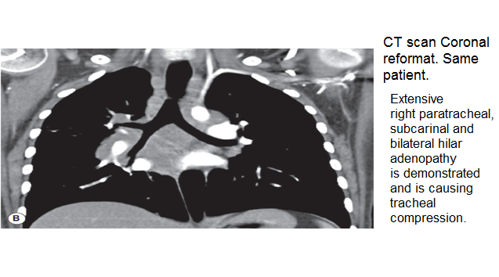
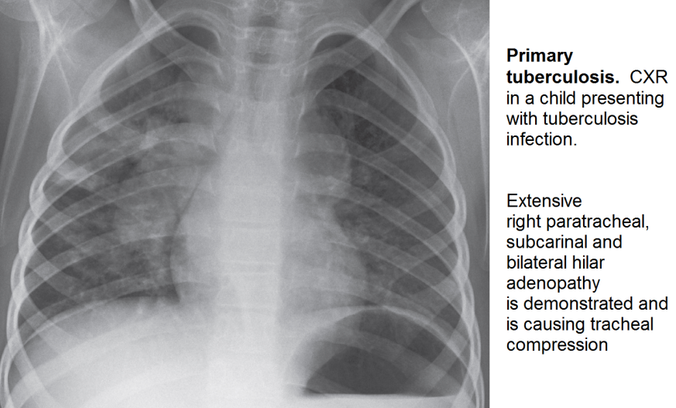
Paediatric TB
Pimary infection
Regional and hilar lymph nodes –Ranke complex
Enlarging caseating lymphadenopathy
Mediastinal lymphadenopathy is the hallmark of primary infection
Prone disseminated disease – multiple lung parenchymal nodules – miliary TB
Effusion and cavitation rare in primary TB
However most children with the primary infection are asymptomatic.

Slide 20
OTHER RADIOLOGICAL FEATURES TB
Apical Consolidation
Pleural effusion
Cavitary lesions (in adolescents and adults only)
Miliary disease
Atelectasis
Lymphadenopathy with or without lung disease
Secondary TB infection
Normal radiograph

Slide 21
References;
Learning radiology – Recognizing the basics — chapter 9
Grainger & Allison's diagnostic radiology
END
THANK YOU

